Slide 1

Encryption

Slide 2
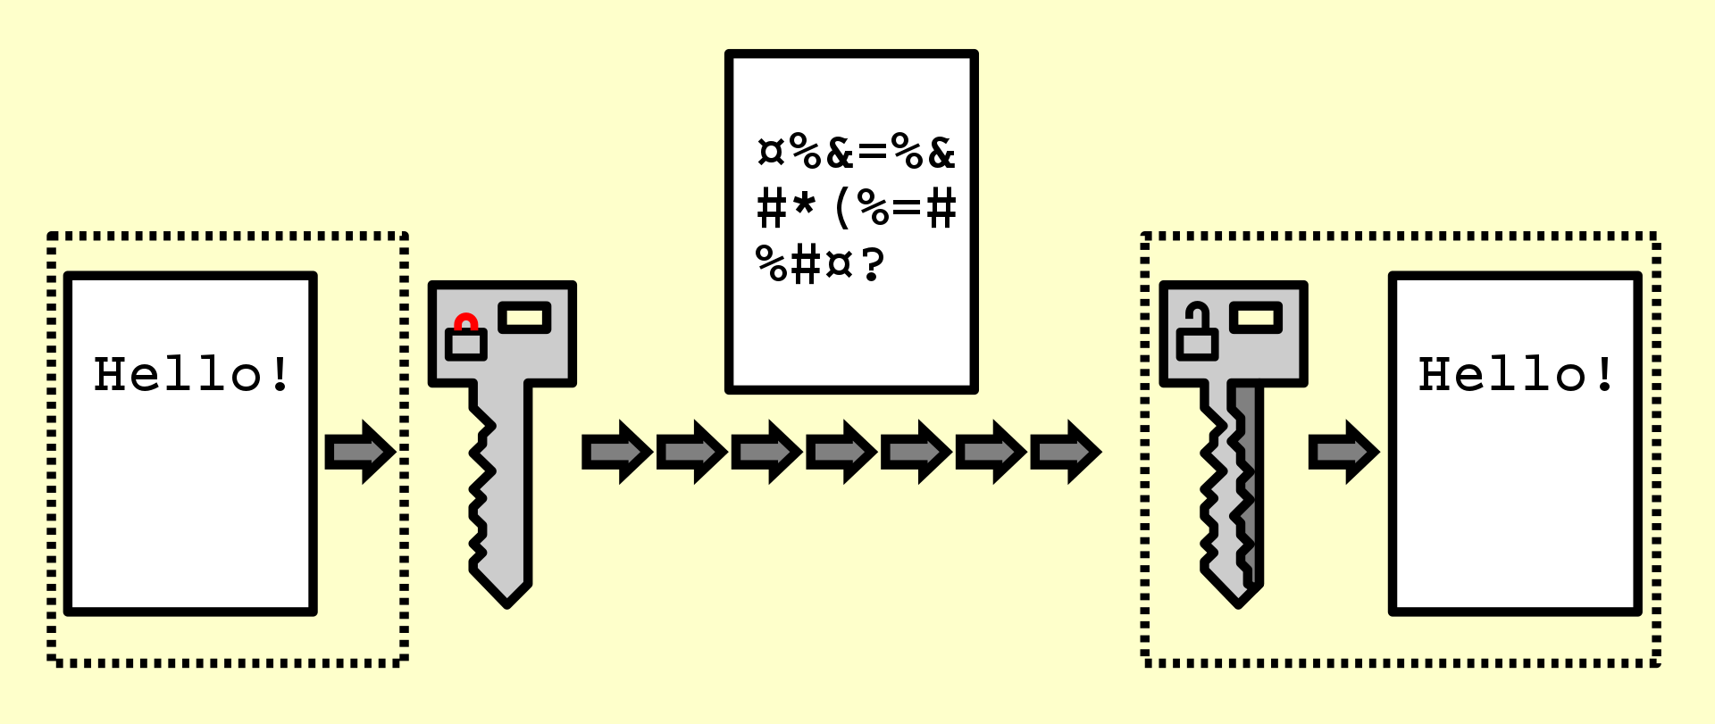
What is encryption?
Process of encoding information
Converts original information into an alternative form
Original form is known as plaintext
Alternative form is known as ciphertext
A key is used to encrypt and decrypt

Slide 3
History of encryption
1900 BC: Symbol replacement encryption, later known as the Caesar Cipher
800s: Arab mathematician developed a technique for cracking Caesar Cipher encryption
1465s: Polyalphabetic Cipher rendered decryption method ineffective
1790s: Thomas Jefferson created a cipher to encode and decode messages, known as the Wheel Cipher
1940s: Axis powers used their Enigma machine to encrypt and decrypt messages
Modern: Encryption is used in the transfer of communication over the Internet

Slide 4
Types of encryption

Slide 5

Symmetric-key scheme
Encryption and decryption use the same key
Nearly all modern cryptographic systems use symmetric-key algorithms for internal encryption
Key Generation: pseudorandom key generators are used, creating a lack of randomness in generation
Advantage: useful for bulk encryption
Drawback: shared key creates security vulnerabilities

Slide 6
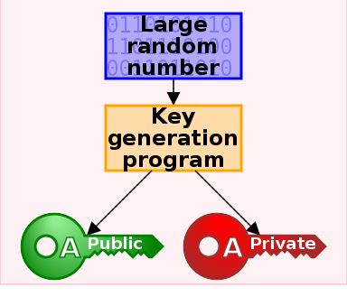
Public-key scheme
Encryption key is published for anyone to use
Only the receiving party has access to decryption key
Public-key can be openly distributed without compromising security
Primarily used to encrypt communication messages

Slide 7
Military use
Encryption is used to protect data in transit
Used over networks, telephone, wireless microphones, etc.
This is primarily done to combat data interception

Slide 8
Data erasure
Conventional methods of permanent data deletion takes a significant amount of time
Cryptography offers a method of erasure almost instantaneous

Slide 9
Python
Python offers multiple libraries for encryption
We used the cryptography library
It uses the symmetric-key scheme
generate_key() method generates a key for encryption and decryption
encrypt(data) method encrypts plaintext data and outputs encrypted bytes (ciphertext)
decrypt(data) method decrypts ciphertext and outputs decrypted bytes

Slide 10
References
https://www.javatpoint.com/cryptography-package-in-python#:~:text=Cryptography%20deals%20with%20the%20encryption,to%20encrypt%20and%20decrypt%20data
https://en.wikipedia.org/wiki/Encryption
https://en.wikipedia.org/wiki/Symmetric-key_algorithm
https://en.wikipedia.org/wiki/Public-key_cryptography

